Slide 1
RAG AI Hands-On Lab
Eric Sowell & Russell Durham

Slide 2



Welcome to Improving
Dallas
a modern digital services company that offers IT consulting, software development, and agile training across the globe.
Improving ATL
http://www.improvingatlanta.com
Help yourself to pizza & a drink in the fridge and make yourself at home.

Slide 3
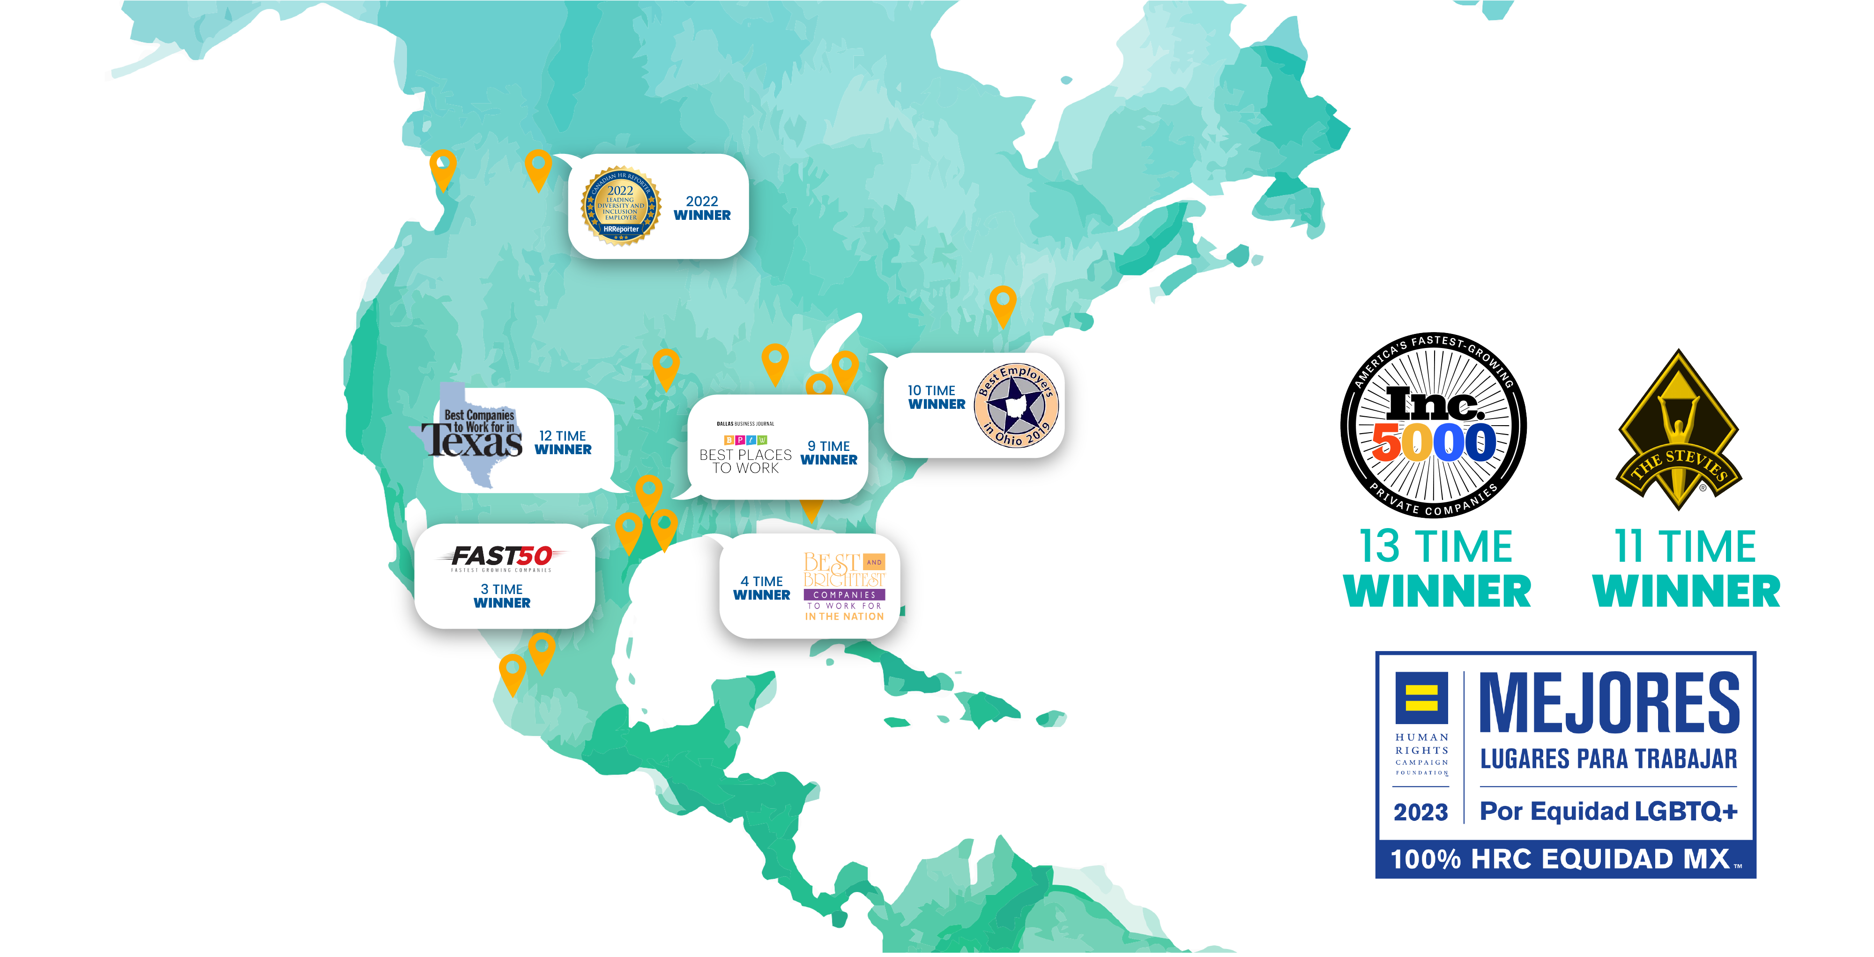
IMPROVING AWARDS – 17 Offices

Slide 4

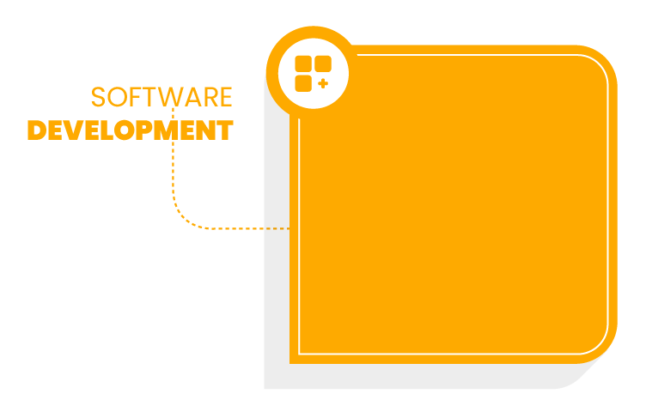



SERVICE OFFERINGS
Development
Cloud
Business Intelligence
Microsoft Solutions
Agile
DevOps
Security
QA
User Experience
Project Management
Digital Transformation
Frontend Development
Cloud
AI / ML
Microsoft Solutions
Agile
Security
QA & Testing
User Experience
Application
Mobile
Web
Microservices
API
Agile Services
Workshops
Private Training
Certifications
Nearshore Development
Staffing & Team Augmentation
Outsourcing Testing
Consulting
For more information on how we can help you contact us at https://improving.com/contact/
Webinars
Conferences
User Groups
CodeLaunch
OpenSource
Speaking Engagements

Slide 5
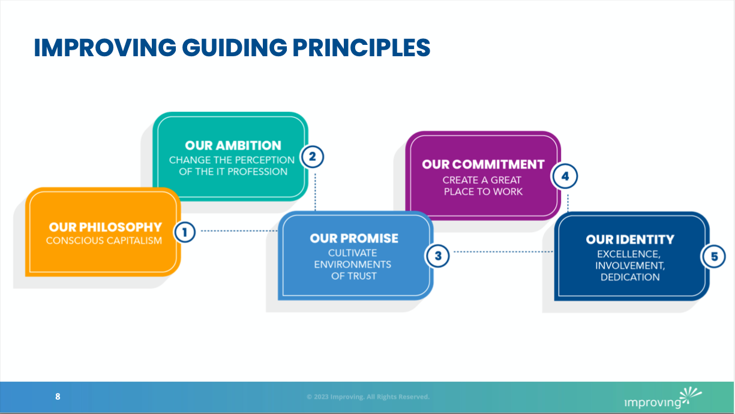

Slide 6
Current User Groups
North Dallas Developers
Entrepreneurs and Innovators Council
ROI Based Agile Coaching
Simple Easy Marketing/Postgress
Java Metroplex
Scaled Agile DFW
Social Media Marketing
Elastic Hacker
DFW Mobile .NET
North Dallas Kubernetees & Cloud Native
eBaybes & eMales
H2O Ai/M3+-
Dallas BI
Plano Prompt Engineers

Slide 7



Russell Durham
Eric Sowell
Senior Consultant, Improving
Director of Consulting, Improving
2+ years with Improving
Oldest of 4 kids.
Standard Nerd
Sci-Fi / Fantasy (books, movies, games)
PC Gamer (Factorio, Star Citizen)
Home Lab and random coding side projects
3+ years with Improving
Drastically prefers shorts over long pants
Non-Standard Nerd
Greek, Latin, and Ancient Lit
Sci-Fi / Fantasy (books, movies, games)
PC Gamer (Civ VI, Age of Empires II, Minecraft)

Slide 8





Retrieval Augmented Generation
What is it?
Query
Query
RAG is a hybrid model that integrates two main components:
Retrieval Component: This part retrieves relevant documents or data from a predefined database or knowledge base.
Generation Component: Using a language model like GPT-3, this part generates coherent and contextually appropriate responses based on the retrieved documents.
By leveraging both components, RAG can produce answers that are not only fluent but also grounded in factual information.
Response
Documents
Query + Documents
Response
Inference Engine

Slide 9
Let’s Code Something!

